Slide 1
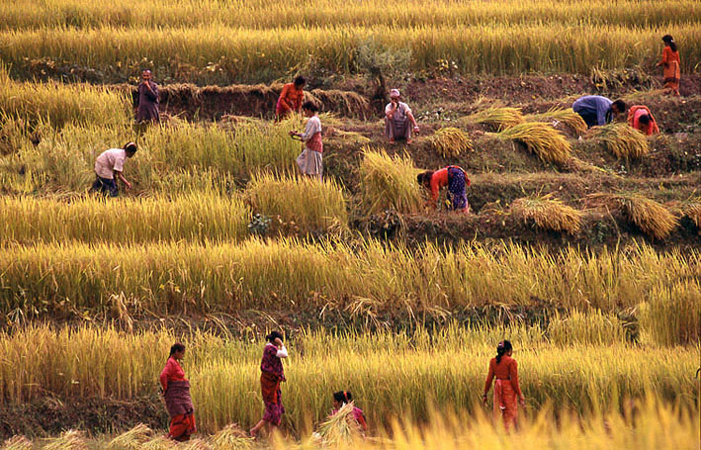
Prayer For Soul Harvest
(March 29th – April 4th )

Slide 2
Psalm 2:8
8 Ask of Me, and I will give You
The nations for Your inheritance,
And the ends of the earth for Your possession.
भजनसंग्रह 2:8
8 मसँग माग, र म जातिहरूलाई तिम्रो उत्तराधिकार तुल्‍याइदिनेछु,
Matthew 9:37
37 Then He said to His disciples, “The harvest truly is plentiful, but the laborers are few.
मत्ती 9:37
37तब उहाँले आफ्‍ना चेलाहरूलाई भन्‍नुभयो, “फसल प्रशस्‍त छ, तर खेतालाहरू थोरै छन्‌। 38यसकारण फसलका प्रभुलाई प्रार्थना गर, र उहाँले आफ्‍नो फसलमा खेतालाहरू पठाइदेऊन्‌।”

Slide 3
Luke 10:2
2 Then He said to them, “The harvest truly is great, but the laborers are few; therefore pray the Lord of the harvest to send out laborers into His harvest.
लूका 10:2
2उहाँले तिनीहरूलाई भन्‍नुभयो, “फसल त प्रशस्‍त छ, तर खेतालाहरू थोरै छन्‌। यसकारण फसलका प्रभुलाई प्रार्थना गर, र उहाँले आफ्‍नो फसलमा खेतालाहरू पठाइदेऊन्‌।
Mark 6:34
34 And Jesus, when He came out, saw a great multitude, and was moved with compassion for them, because they were like sheep not having a shepherd. So, He began to teach them many things.
मर्कूस 6:34
34जब उहाँ किनारमा उत्रनुभयो तब उहाँले एउटा ठूलो भीड देख्‍नुभयो, र उहाँले तिनीहरूलाई टिठ्याउनुभयो। किनकि तिनीहरू गोठालो नभएका भेड़ाहरूजस्‍ता थिए। र उहाँले तिनीहरूलाई धेरै कुरा सिकाउन लाग्‍नुभयो।

Slide 4
1 Kings 22:17, 2nd Chronicles 18:16
17 Then he said, “I saw all Israel scattered on the mountains, as sheep that have no shepherd. And the Lord said, ‘These have no master. Let each return to his house in peace.’ ”
१ राजाहरू 22:17, २ इतिहास 18:16
17तब मीकायाले जवाफ दिए, “मैले त सबै इस्राएललाई गोठाला नभएका भेड़ाहरूझैँ डाँड़ाहरूतिर तितरबितर भएका देखें, र परमप्रभुले यसो भन्‍नुभयो, ‘यी मानिसहरूका मालिक छैनन्‌। हरेक शान्‍तिसित घर जाओस्‌’।”
Ezekiel 34:5-6
5 So they were scattered because there was no shepherd; and they became food for all the beasts of the field when they were scattered. 6 My sheep wandered through all the mountains, and on every high hill; yes, My flock was scattered over the whole face of the earth, and no one was seeking or searching for them.”
इजकिएल 34: 5 – 6
5यसैले तिनीहरू छरपष्‍ट भए, किनकि तिनीहरूको गोठालो नै थिएन। जब तिनीहरू छरपष्‍ट भए, तब तिनीहरू जङ्गली जनावरका शिकार भए। 6मेरा भेड़ाहरू बाटो बिराएर पहाड़हरू र हरेक अल्‍गो डाँड़ामा गए। तिनीहरू सारा पृथ्‍वीभरि नै छरपष्‍ट भए, र कसैले तिनीहरूको खोजी अथवा सोधपूछ गरेन।

Slide 5
Matthew 12:29, Mark 3:27
29 Or how can one enter a strong man’s house and plunder his goods, unless he first binds the strong man? And then he will plunder his house.
मत्ती 12:29, मर्कूस 3:27
29 “पहिले बलियो मानिसलाई नबाँधिकन, त्‍यसको घरभित्र पसेर कसले त्‍यसको धनमाल लिएर जान सक्‍छ? त्‍यस बलियो मानिसलाई बाँधेपछि मात्र त्‍यसको घर लुट्‌न सक्‍छ।
Matthew 16:19
19 And I will give you the keys of the kingdom of heaven, and whatever you bind on earth [a]will be bound in heaven, and whatever you loose on earth will be loosed in heaven.”
मत्ती 16:19
19 म तिमीलाई स्‍वर्गको राज्‍यका साँचाहरू दिनेछु। जे तिमीले पृथ्‍वीमा बाँध्‍नेछौ, सो स्‍वर्गमा बाँधिनेछ, र जे तिमीले पृथ्‍वीमा फुकाऔला, सो स्‍वर्गमा फुकाइनेछ।”

Slide 6
Matthew 18:18
18 “Assuredly, I say to you, whatever you bind on earth will be bound in heaven, and whatever you loose on earth will be loosed in heaven.
मत्ती 18:18
18 “साँच्‍चै, म तिमीहरूलाई भन्‍दछु, तिमीहरूले पृथ्‍वीमा जे बाँध्‍छौ, त्‍यो स्‍वर्गमा बाँधिनेछ। अनि तिमीहरूले पृथ्‍वीमा जे फुकाउँछौ त्‍यो स्‍वर्गमा फुकाइनेछ।
John 14:12-14
12 “Most assuredly, I say to you, he who believes in Me, the works that I do he will do also; and greater works than these he will do, because I go to My Father. 13 And whatever you ask in My name, that I will do, that the Father may be glorified in the Son. 14 If you [a]ask anything in My name, I will do it.
यूहन्‍ना 14:12 – 14
12 “साँच्‍चै, म तिमीहरूलाई भन्‍दछु, जसले मलाई विश्‍वास गर्दछ, त्‍यसले मैले गरेका काम पनि गर्नेछ, र तीभन्‍दा ठूला काम गर्नेछ, किनभने म पिताकहाँ गइरहेछु। 13तिमीहरूले मेरो नाउँमा जेसुकै मागे तापनि पुत्रमा पिताको महिमा होस्‌ भनेर म त्‍यो गर्नेछु। 14तिमीहरूले मेरो नाउँमा कुनै थोक माग्‍यौ भने म गरिदिनेछु।

Slide 7
Isaiah 58:6-7
6 “Is this not the fast that I have chosen: To lose the bonds of wickedness, To undo the [a]heavy burdens, To let the oppressed, go free, And that you break every yoke? 7 Is it not to share your bread with the hungry, And that you bring to your house the poor who are [b]cast out. When you see the naked, that you cover him, And not hide yourself from your own flesh?
यशैया 58:6 – 7
6“अन्‍यायको बन्‍धन फुकाल्‍न, जुवाको डोरी फुकाल्‍न, र अत्‍याचारमा परेकाहरूलाई मुक्त गराउन, हरेक जुवा भाँचिदिन मैले चुनेको किसिमको उपवास यही होइन र? 7आफ्‍नो भोजन भोकासित बाँड़चूँड़ गर्नु, र घर नभएका गरीबहरूलाई शरण दिनु— नाङ्गोलाई देखेर लुगा लगाइदिनु, र आफ्‍नो जात-भाइहरूबाट नलुक्‍नु, होइन र?
Luke 10:19
19 Behold, I give you the authority to trample on serpents and scorpions, and over all the power of the enemy, and nothing shall by any means hurt you.
लूका 10:19
19 मैले तिमीहरूलाई सर्पहरू र बिच्‍छीहरू कुल्‍चने र शत्रुको सारा शक्तिमाथि अधिकार दिएको छु, र कुनै कुराले तिमीहरूलाई हानि गर्नेछैन।

Slide 8
Mark 16:15,17-18
15 And He said to them, “Go into all the world and preach the gospel to every creature. 17 And these signs will follow those who [a]believe: In My name they will cast out demons; they will speak with new tongues; 18 they[b] will take up serpents; and if they drink anything deadly, it will by no means hurt them; they will lay hands on the sick, and they will recover.”
मर्कूस 16: 15,17 – 18
15अनि उहाँले तिनीहरूलाई भन्‍नुभयो, “सारा संसारमा गएर सारा सृष्‍टिलाई सुसमाचार प्रचार गर। 17विश्‍वास गर्नेहरूसँग यी चिन्‍हहरू हुनेछन्‌— मेरो नाउँमा तिनीहरूले भूतहरू धपाउनेछन्, तिनीहरूले नयाँ भाषाहरूमा बोल्‍नेछन्, 18तिनीहरूले सर्पहरू समात्‍नेछन्‌ र कुनै विषालु कुरा पिए तापनि कुनै किसिमले त्‍यसले तिनीहरूको हानि गर्नेछैन। तिनीहरूले रोगीहरूमाथि आफ्‍ना हात राख्‍नेछन्‌ र तिनीहरू निको हुनेछन्‌।

