Slide 1
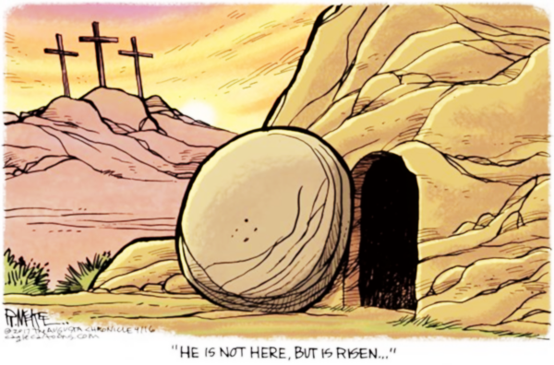
The lamb that was slain, He's alive
Forever He shall reign, He's alive
Oh they crucified, at calvary, but He rose in victory
He's alive (He's alive)
He's alive (He's alive)
He's alive (He's alive)
He is Risen

Slide 2
Oh with all power in His Hands!
Jesus, He's alive (He's alive)
He is alive (He's alive)
He's alive (He's alive)
With all power in His Hands!
He is Risen

Slide 3
He rose (He rose)
In Glory (in glory)
With all power (with all power)
And authority (and authority)
He conquered (He conquered)
My enemies (My enemies)
And He put them under my feet (He put them)
He is Risen

